Slide 1
8.5 Therac-25
1-<number>

Slide 2
Genesis of the Therac-25
AECL and CGR built Therac-6 and Therac-20
Therac-25 built by AECL
  PDP-11 an integral part of system
  Hardware safety features replaced with software
  Reused code from Therac-6 and Therac-20
First Therac-25 shipped in 1983
  Patient in one room
  Technician in adjoining room
1-<number>

Slide 3
Chronology of Accidents and AECL Responses
Marietta, Georgia (June 1985)
Hamilton, Ontario (July 1985)
First AECL investigation (July-Sept. 1985)
Yakima, Washington (December 1985)
Tyler, Texas (March 1986)
Second AECL investigation (March 1986)
Tyler, Texas (April 1986)
Yakima, Washington (January 1987)
FDA declares Therac-25 defective (February 1987)
1-<number>

Slide 4
Software Errors
Race condition: order in which two or more concurrent tasks access a shared variable can affect program’s behavior
Two race conditions in Therac-25 software
  Command screen editing
  Movement of electron beam gun
1-<number>

Slide 5
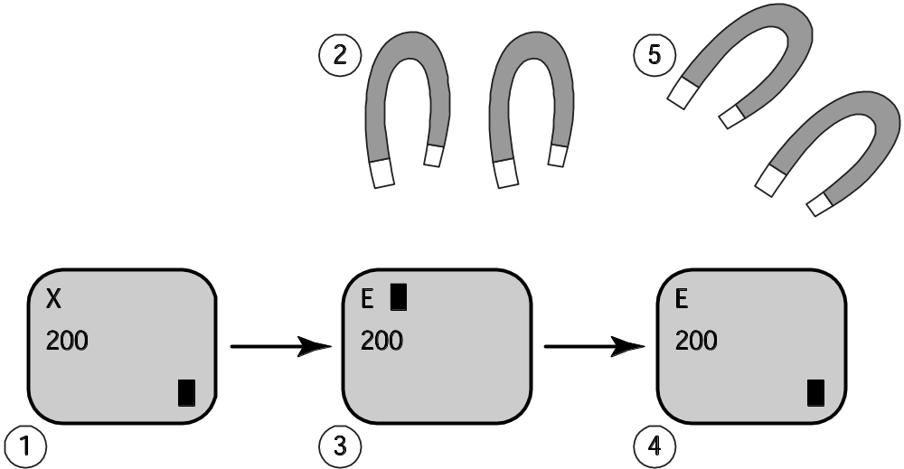
Race Condition Revealed by Fast-typing Operators
1-<number>

Slide 6
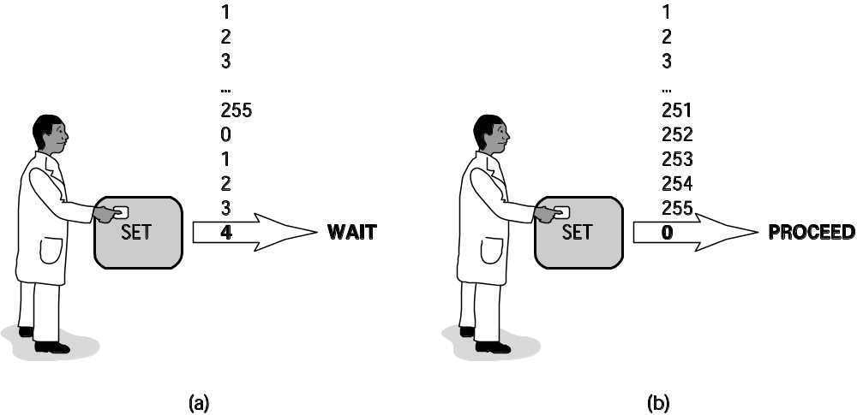
Race Condition Caused by Counter Rolling Over to Zero
1-<number>

Slide 7
Post Mortem
AECL focused on fixing individual bugs
System not designed to be fail-safe
No devices to report overdoses
Software lessons
  Difficult to debug programs with concurrent tasks
  Design must be as simple as possible
  Documentation crucial
  Code reuse does not always lead to higher quality
AECL did not communicate fully with customers
1-<number>

Slide 8
Moral Responsibility of the
Therac-25 Team
Conditions for moral responsibility
  Causal condition: actions (or inactions) caused the harm
  Mental condition
    Actions (or inactions) intended or willed -OR-
    Moral agent is careless, reckless, or negligent
Therac-25 team morally responsible
  They constructed the device that caused the harm
  They were negligent
1-<number>

Slide 9
Postscript
Computer errors related to radiation machines continue to maim and kill patients
Investigation by The New York Times
  Scott Jerome-Parks, New York (2006)
  Alexandra Jn-Charles, New York (2006)
1-<number>

Slide 10
8.6 Computer Simulations
1-<number>

Slide 11
Uses of Simulations
Simulations replace physical experiments
  Experiment too expensive or time-consuming
  Experiment unethical
  Experiment impossible
Model past events
Understand world around us
Predict the future
1-<number>

Slide 12
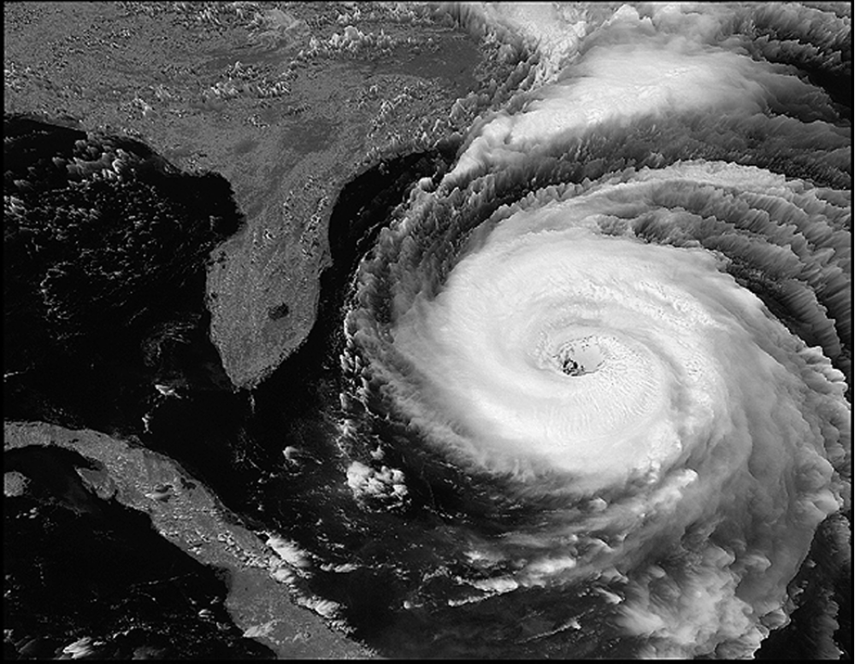
Simulations Predict Path and Speed of Hurricanes
Courtesy of NASA
1-<number>

Slide 13
Validating Simulations
Verification: Does program correctly implement model?
Validation: Does the model accurately represent the real system?
Validation methods
  Make prediction, wait to see if it comes true
  Predict the present from old data
  Test credibility with experts and decision makers
1-<number>

Slide 14
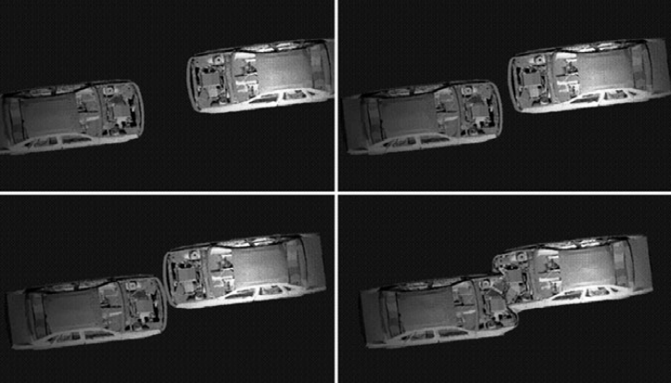
Validating a Model
1-<number>

Slide 15
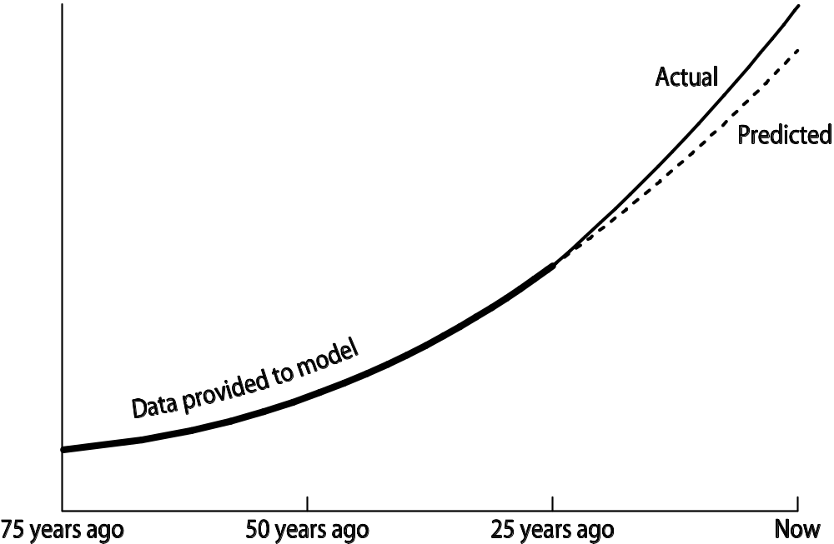
Validation by “Predicting the Present”
1-<number>

